Slide 1
LOAN MANAGEMENT SYSTEM
SQL PROJECT PRESENTATION BY DINESH KUMAR I

Slide 2
INTRODUCTION
Overview of SQL
→ Structured Query Language (SQL) is essential for managing and querying relational databases.
→ Helps in efficient data filtering, retrieval, and analysis.
Introduction to Loan Management System
→ A system designed to manage customer details and loan sanctioning processes.
→ Ensures accurate data processing for better decision-making.
Purpose of the Project
→ Filtering customer details based on various criteria.
→ Analyzing customer data to assess loan eligibility.
→ Streamlining loan approval and sanctioning processes.
→ Improving accuracy and efficiency in loan management.

Slide 3
SQL BASICS
Popular SQL Databases:
MySQL, PostgreSQL, SQL Server, Oracle
Types of SQL Commands:
→ DDL (Data Definition Language): Defines database structure (e.g., create, alter, drop).
→ DML (Data Manipulation Language): Modifies data (e.g., insert, update, delete).
→ DCL (Data Control Language): Manages permissions (e.g., grant, revoke).
→ TCL (Transaction Control Language): Handles transactions (e.g., commit, rollback).
DQL (Data Query Language): Retrieves data (e.g., select).
Importance of Constraints:
→ Primary Key: Uniquely identifies each record.
→ Foreign Key: Maintains referential integrity between tables.
→ Unique: Ensures all values in a column are distinct.
→ Not Null: Prevents null values in a column.
→ Check: Enforces specific conditions on column values.
→ Auto Increment: Automatically generates unique values for a column.

Slide 4
PROJECT OVERVIEW
A system that manages the entire loan lifecycle.
Tracks payments, eligibility, interest calculations, defaults.
Efficiently integrates customer and loan data.

Slide 5
INITIALIZATION
create database project_1;
create database project_1_dummy;
use project_1_dummy;
set autocommit = off;
start transaction;
/*[TCP used to retrive if unfortunate mistakes happend]*/
LOAN MANAGEMENT SYSTEM
2025

Slide 6
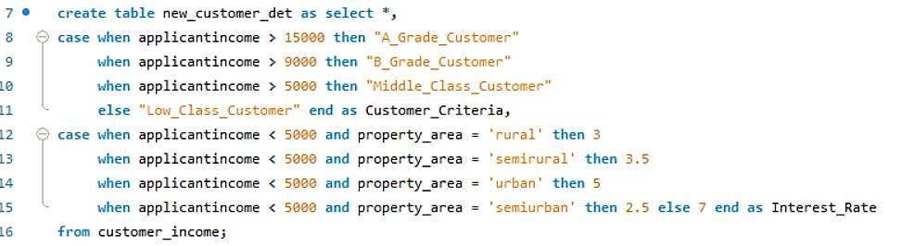
Loan Criteria & CASE Statements

Slide 7
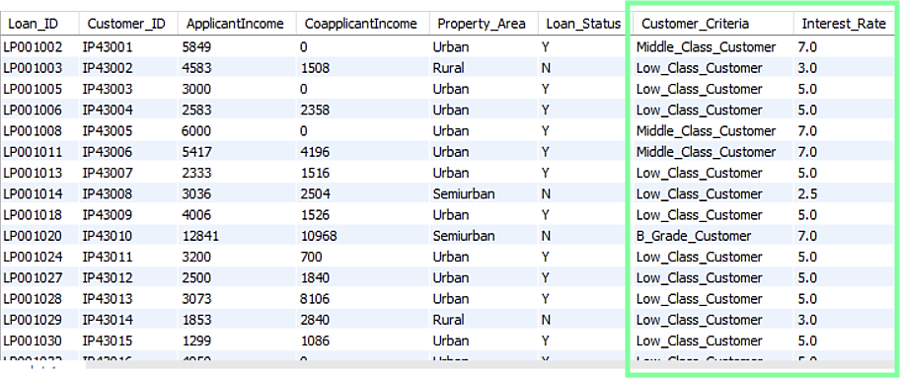
CREATED TABLE NEW_CUSTOMER_DET

Slide 8
Triggers & Loan Status Management
Triggers are automated actions executed when a
specific event occurs in a table (e.g., INSERT, UPDATE, DELETE)
Used for enforcing business rules,
maintaining audit logs, and automating data updates.
Types of Triggers:
Row-Level Triggers: Executes once per affected row.
Statement-Level Triggers: Executes once per triggering
statement, regardless of the number of affected rows.
Example: Loan Status Management with Triggers
Before Insert: Validate the CIBIL score before
inserting a new loan record.
After Insert: Automatically update the
loan status based on eligibility.
LOAN MANAGEMENT SYSTEM
2025

Slide 9
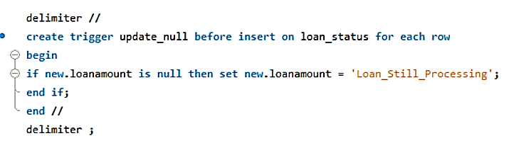
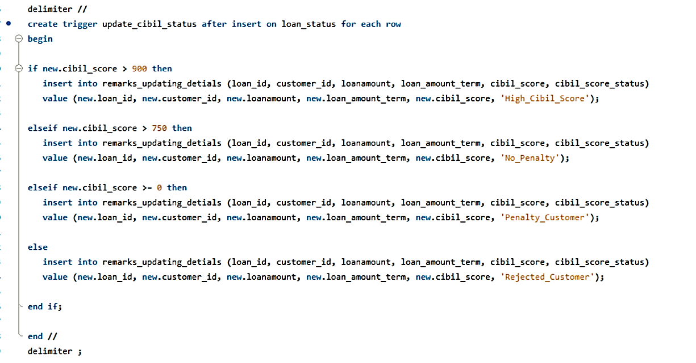
Trigger Statements

Slide 10

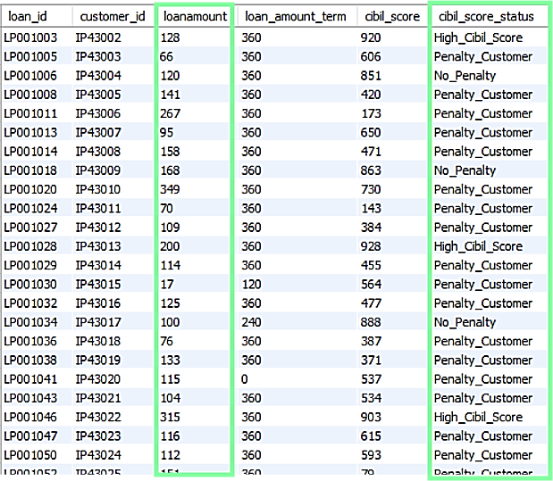
INSERTED AND REMOVED REJECTED CUSTOMERS FROM REMARKS UPDATING TABLE

Slide 11

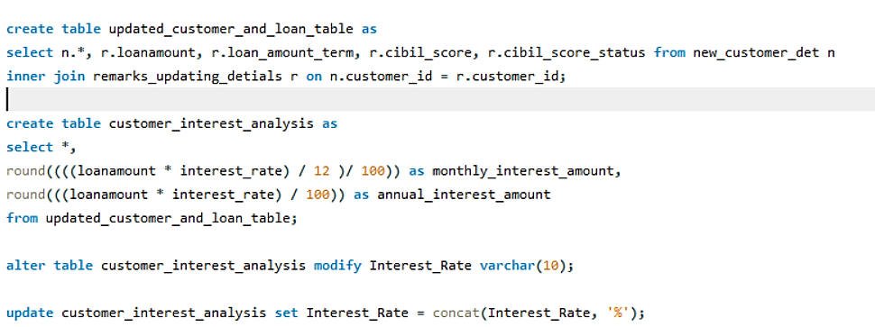
NEW TABLE CREATED AFTER JOINING FILTERED TABLES AND CALCULATION PART

Slide 12
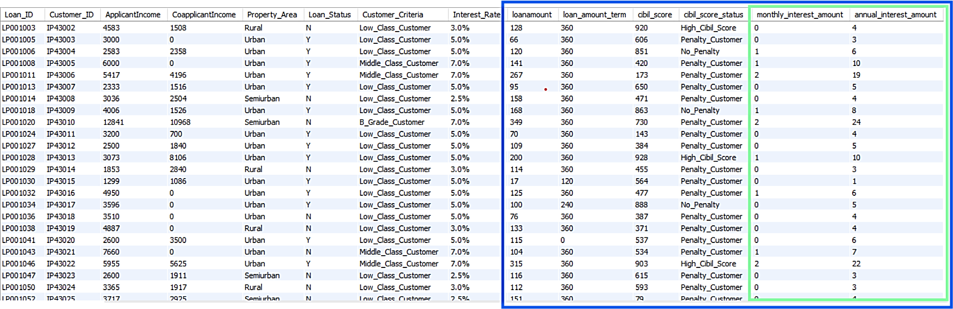
AFTER ALL MODIFICATION CREATED CUSTOMER INTEREST ANALYSIS TABLE

Slide 13
TABLE CREATION ERRORS DURING EXECUTION
AFTER LOT OF ERRORS FINALLY TABLE CREATED CUSTOMER_﻿INTEREST_ANALYSIS.
MOST COMMON ERRORS ARE COLUMN OR TABLE NAMES MISTAKES, DATATYPE MISTAKES, TRIGGER MISTAKES.
LOT OF ERROR OCCURRED ON TRIGGER INSERT. WHAT I FACED WAS CANNOT BE ABLE TO IMPORT NEEDED TO BE MANUAL INSERT VALUES AND TRIGGER EXECUTION MISTAKES IN MY DATATYPE ERRORS OCCURRED LIKE VARCHAR (SIZE NEEDED TO BE EXTEND) INCREASED TO 55.
THEN THE WORKFLOW BECOME NORMAL JOINED BOTH NEWLY CREATED TABLES WITHOUT REPEATING COLUMNS AND CALCULATED MONTHLY INTEREST AMOUNT THEN ANNUAL INTEREST AMOUNT.
FINNALY CUSTOMER_INTEREST_ANALYSIS TABLE CREATED AND ADDED PERCENTAGE SYMBOL % FOR INTEREST_RATE COLUMN IN TABLE.
LOAN MANAGEMENT SYSTEM
2025

Slide 14
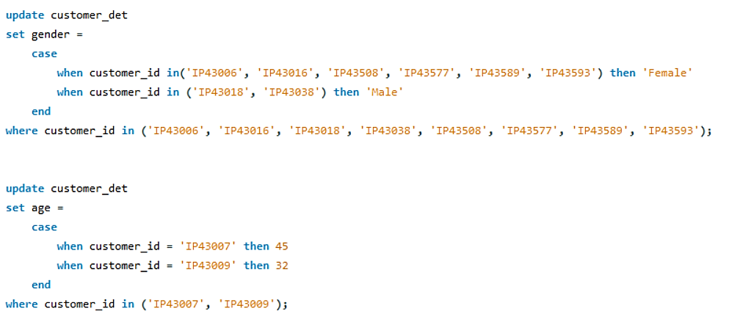
CUSTOMER DETAILS TABLE UPDATION COMMAND USING CASE-END

Slide 15
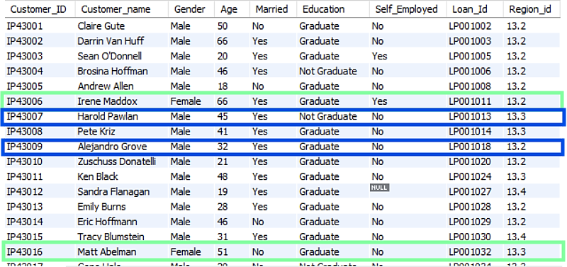
AFTER UPDATED DATA IN CUSTOMER DETIALS TABLE

Slide 16
JOINS IN SQL
INNER JOIN – Returns only matching records from both tables.
LEFT JOIN – Returns all records from the left table and matching records from the right table. If no match is found, NULL is returned for right table columns
.
RIGHT JOIN – Returns all records from the right table and matching records from the left table. If no match is found, NULL is returned for left table columns.
FULL JOIN – Returns all records from both tables.If there’s no match, NULL is returned for the missing values from either table.
SELF JOIN – Joins a table with itself to compare records within the same table.
CROSS JOIN – Returns the Cartesian product of both tables, meaning every row from the first table is paired with every row from the second table.
LOAN MANAGEMENT SYSTEM
2025

Slide 17
Use of Stored Procedures
A stored procedure is a precompiled SQL block that can be executed multiple times.
Used to perform complex operations efficiently.
Importance of Stored Procedures:
Improves performance by reducing query compilation time.
Enhances security by restricting direct table access.
Supports modular programming for better maintainability.
Benefits in SQL Projects:
Reusability: Can be executed multiple times without rewriting queries.
Consistency: Ensures standardized business logic.
Optimization: Reduces redundant query execution and enhances performance.
LOAN MANAGEMENT SYSTEM
2025

Slide 18
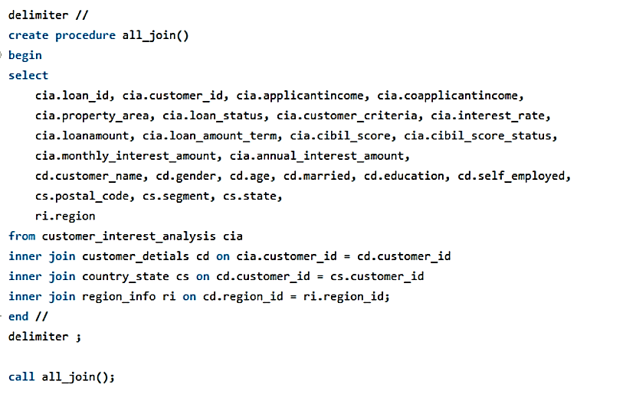
QUERY OF RESULT 1 IN PROCEDURE JOIN ALL THE TABLES WITHOUT REPEATING COLUMNS

Slide 19
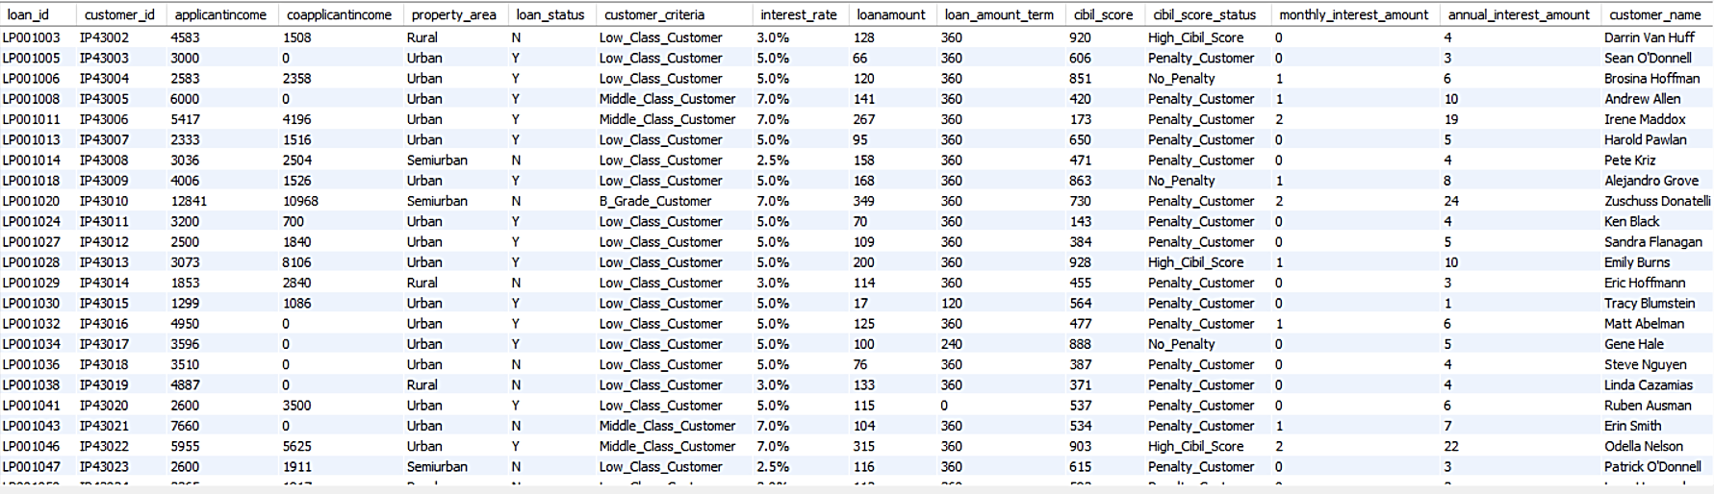
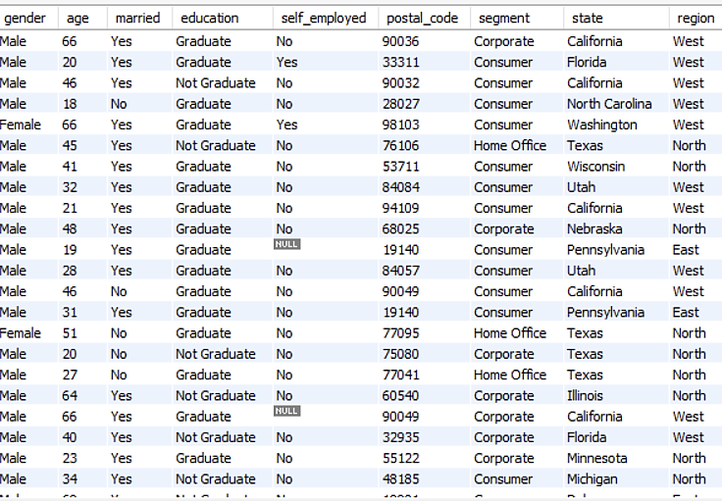
RESULT 1 OUTPUT IN TABLE FORMAT

Slide 20
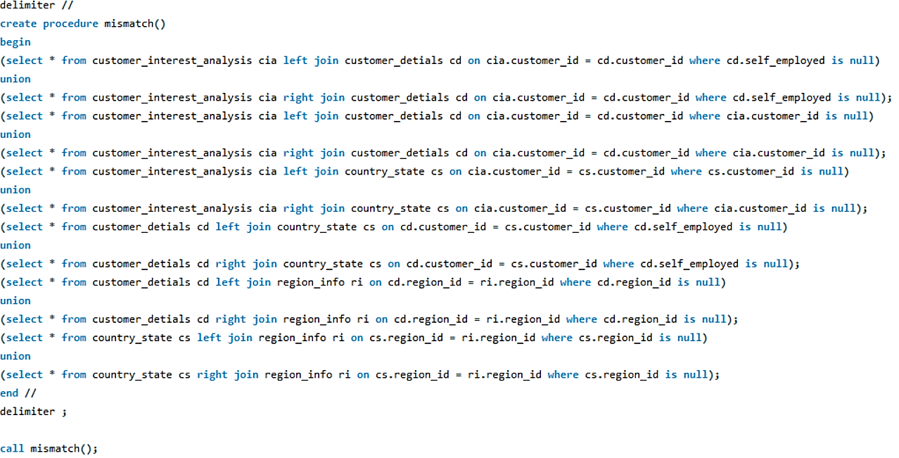
QUERY OF RESULT 2 IN PROCEDURE FIND MISMATCH COLUMNS IN THE TABLES

Slide 21

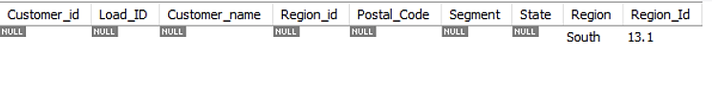
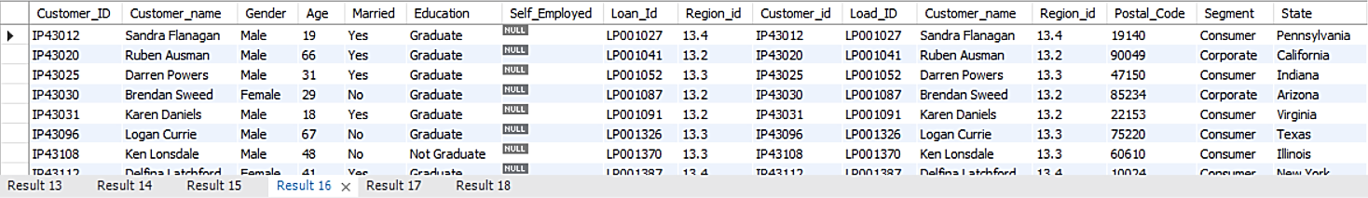
RESULT 2 OUTPUT IN TABLE FORMAT

Slide 22
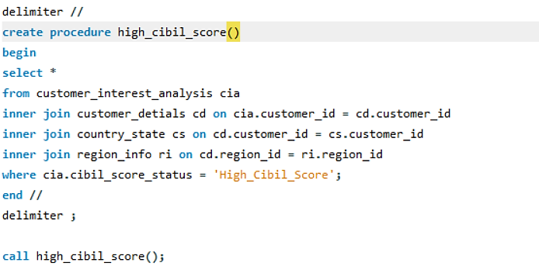
QUERY OF RESULT 3 IN PROCEDURE FILTER HIGH_CIBIL_SCORE CUSTOMERS IN THE TABLES

Slide 23
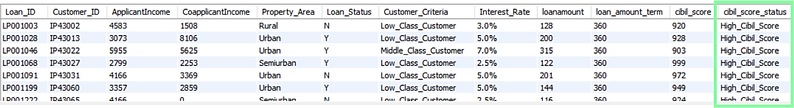
RESULT 3 OUTPUT IN TABLE FORMAT

Slide 24
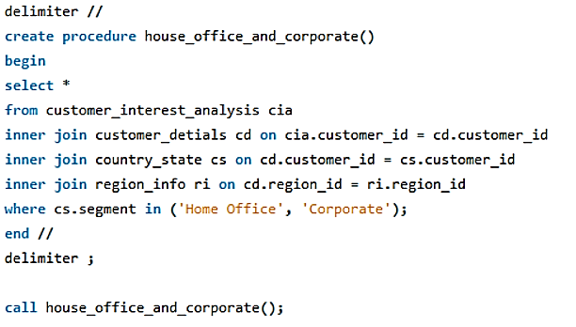
QUERY OF RESULT 4 IN PROCEDURE FILTER IN SEGMENT COLUMN HOME_OFFICE AND CORPORATE CUSTOMERS IN THE TABLES

Slide 25
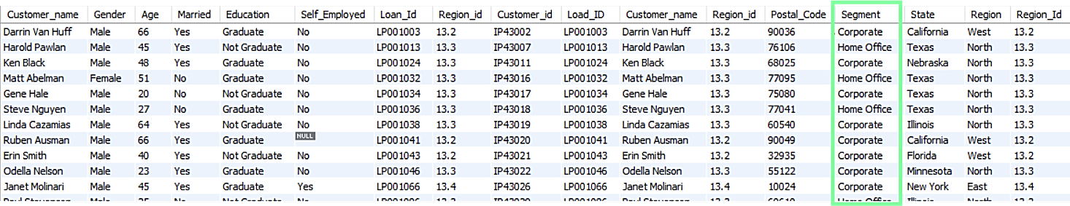
RESULT 4 OUTPUT IN TABLE FORMAT

Slide 26
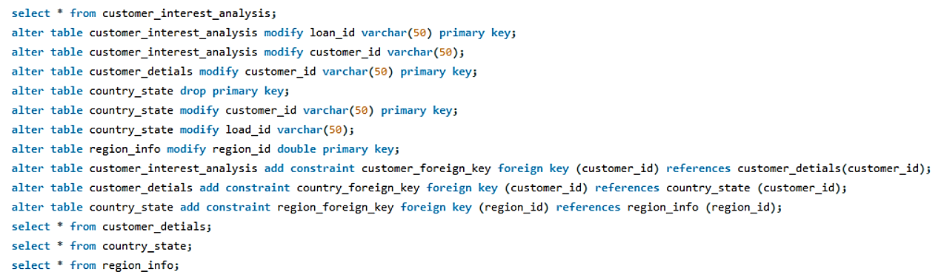
ALTERATION OF IMPORTED DATA’S COLUMN DATATYPE AND ADDING PRIMARY KEY AND THE FOREIGN KEY FOR EER DIAGRAM

Slide 27
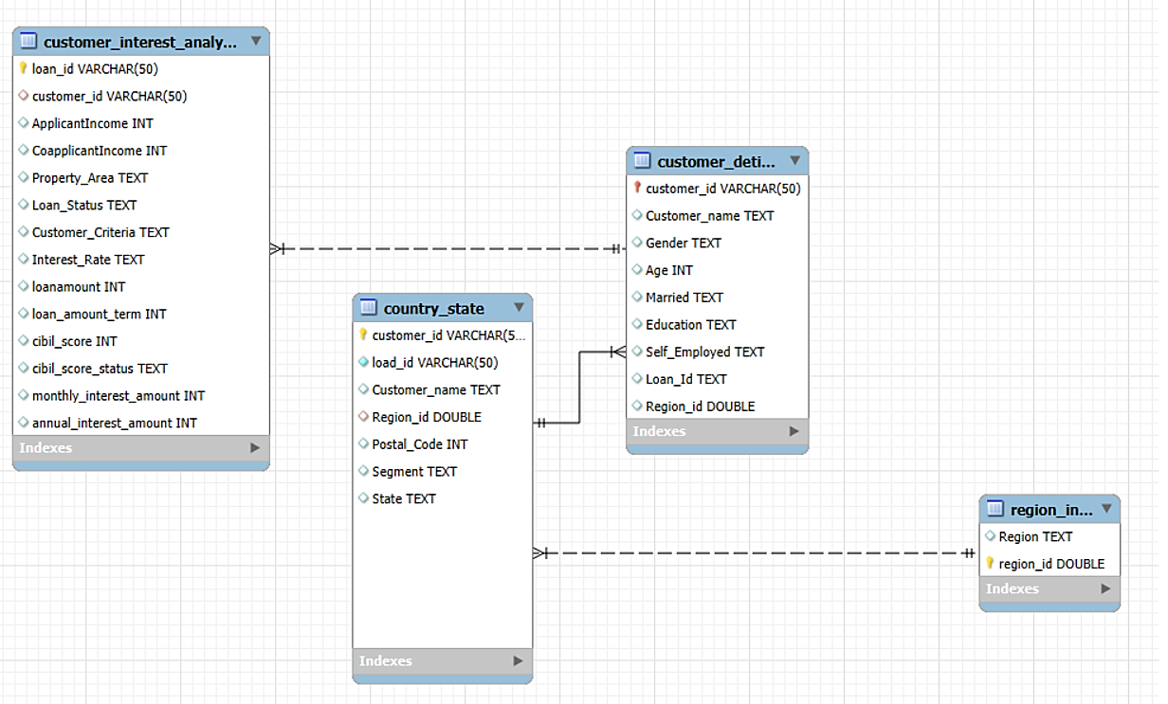
EER DIAGRAM OF FOUR TABLES CONNECTED USING FOREIGN KEY

Slide 28
CONCLUSION
→ This project demonstrates how SQL is used to efficiently manage loan-related data.
→ By implementing transactions, joins, triggers, stored procedures, foreign key, and filtering techniques, we automate and streamline the loan management process.
→ The system helps in customer data analysis, loan eligibility assessment, and seamless loan processing.
→ Using SQL best practices, we improve data integrity, accuracy, and efficiency in loan management.
Thank You!

